Slide 1

The setting changes. The spirit never does.
INTERNAL WORKING MASTER · NOT FOR SHARING · 28 OCTOBER 2026
Notes:
USE IN: Brand story · Partner Mode pack · Event Mode pack · Internal master only
SECTION: Cover
28 OCT PASS: Added the supporting line and an internal-master label (remove the label in any shared version).

Slide 2
Our purpose: Where human connection thrives.
Our vision: A world where shared experiences create lasting connections, memories and a sense of belonging.
Our approach: Inspire. Discover. Experience. Belong.
The setting changes. The spirit never does.
Notes:
USE IN: Internal master only (purpose and vision are internal, not consumer lines)
SECTION: Brand
28 OCT, LINE HIERARCHY (founder): one line per job. Purpose: Where human connection thrives (sits above the vision). Vision: merged from the two earlier purpose and vision lines. Approach: the brand journey. Brand line: The setting changes. The spirit never does. "Everyone has something worth saying" stays a supporting line, off this slide. Queued for the Brand Brain.

Slide 3
The setting changes. The spirit never does.
Everything we do starts with a simple belief: conversation flows when nobody is worried about getting it right. Conversation not knowledge.
Among friends
What people take away
Wine is our first invitation
Entre Amis is French for “between friends”. Everyone is welcome, and everyone has something worth saying.
Not a score or a lesson. Stories, discoveries, people and moments worth returning to.
A glass on the table is a natural place to start a conversation. Wine is where we begin, not where we stop.
Say what you really think.
Notes:
USE IN: Brand story · Partner Mode pack · Event Mode pack
SECTION: Brand
28 OCT PASS: Confirmed idea wording; claim "conversations are better" and benefit claim "makes it easier" removed; bottle line replaced (responsible drinking).

Slide 4
The friend you want at the table
Knows enough to make things interesting. Never makes anyone feel left out.
Warm, never worthy
Curious, never corrective
Premium, never precious
Playful, never silly
Knowledge is shared generously, never used as status.
Any wine belongs. Every opinion counts. We help people discover; we never correct.
Considered design and materials. Relaxed enough to use. Beautiful enough to belong on the table.
Wit, conversation and a little mischief, but always grown-up and inclusive.
When you’re at an Entre Amis table, nobody has
to prove they belong there.
Say what you really think.
Notes:
USE IN: Brand story · Partner Mode pack
SECTION: Brand
28 OCT PASS: Added "Warm, never worthy" so all four tone pairs show, in Brand Brain order. Subtitle uses the first confirmed behaviour.

Slide 5
The Entre Amis journey
Connection, discovery, shared experiences and memories. Wine is the first place we bring them to life.
Inspire → Discover → Experience → Belong
Inspire: Open the door to ideas, places, people and occasions
Discover: Explore, learn and enjoy
Experience: Take part, play, connect and share
Belong: Keep memories, deepen relationships and have reasons to return
Personalisation connects the journey: one account, so each experience can build on the last.
Play can happen at any stage. It isn’t always the first step.
Say what you really think.
Notes:
USE IN: Brand story
SECTION: Brand
28 OCT PASS: Retitled as the brand journey. Personalisation line kept and made plain; the Brand Brain does not mention personalisation yet (flagged).

Slide 6
Two audiences, one connected brand
One brand. Different ways to connect, discover and experience.
DIRECT TO CONSUMERS
COMMERCIAL PARTNERS
The game
The app
Entre Amis stays
Partner Mode
Event Mode
Premium, giftable and designed for real tables.
Supports play and discovery, and keeps the moments people want to return to.
The vision: Entre Amis, lived for a few days.
Hosted tastings for one venue or producer: engagement, relationships and insight.
Entre Amis across a combined event, for visitors, producers and organisers.
CONNECTED PLATFORM, DATA AND INSIGHT
One connected experience across Entre Amis, built with consent: personalisation, useful insight and reasons to return.
Say what you really think.
Notes:
USE IN: Internal master only · Brand story
SECTION: Brand
28 OCT PASS: Retitled so it does not duplicate slide 7. Section colours approved (28 October). Stays shown as part of the vision (approved 28 October). Contains internal language (economics, insight) - internal use only.
PASS 4 (28 OCT): rebuilt on an even five-column grid with more space; arrows now in brand colours (deep olive for consumers and the platform, blush for partners). Stays shown as part of the vision.
Stays card shortened (founder, 28 Oct). Moved here: in Provence; built when the brand and economics are ready. Location kept off this overview slide; Provence stays on slide 17.

Slide 7
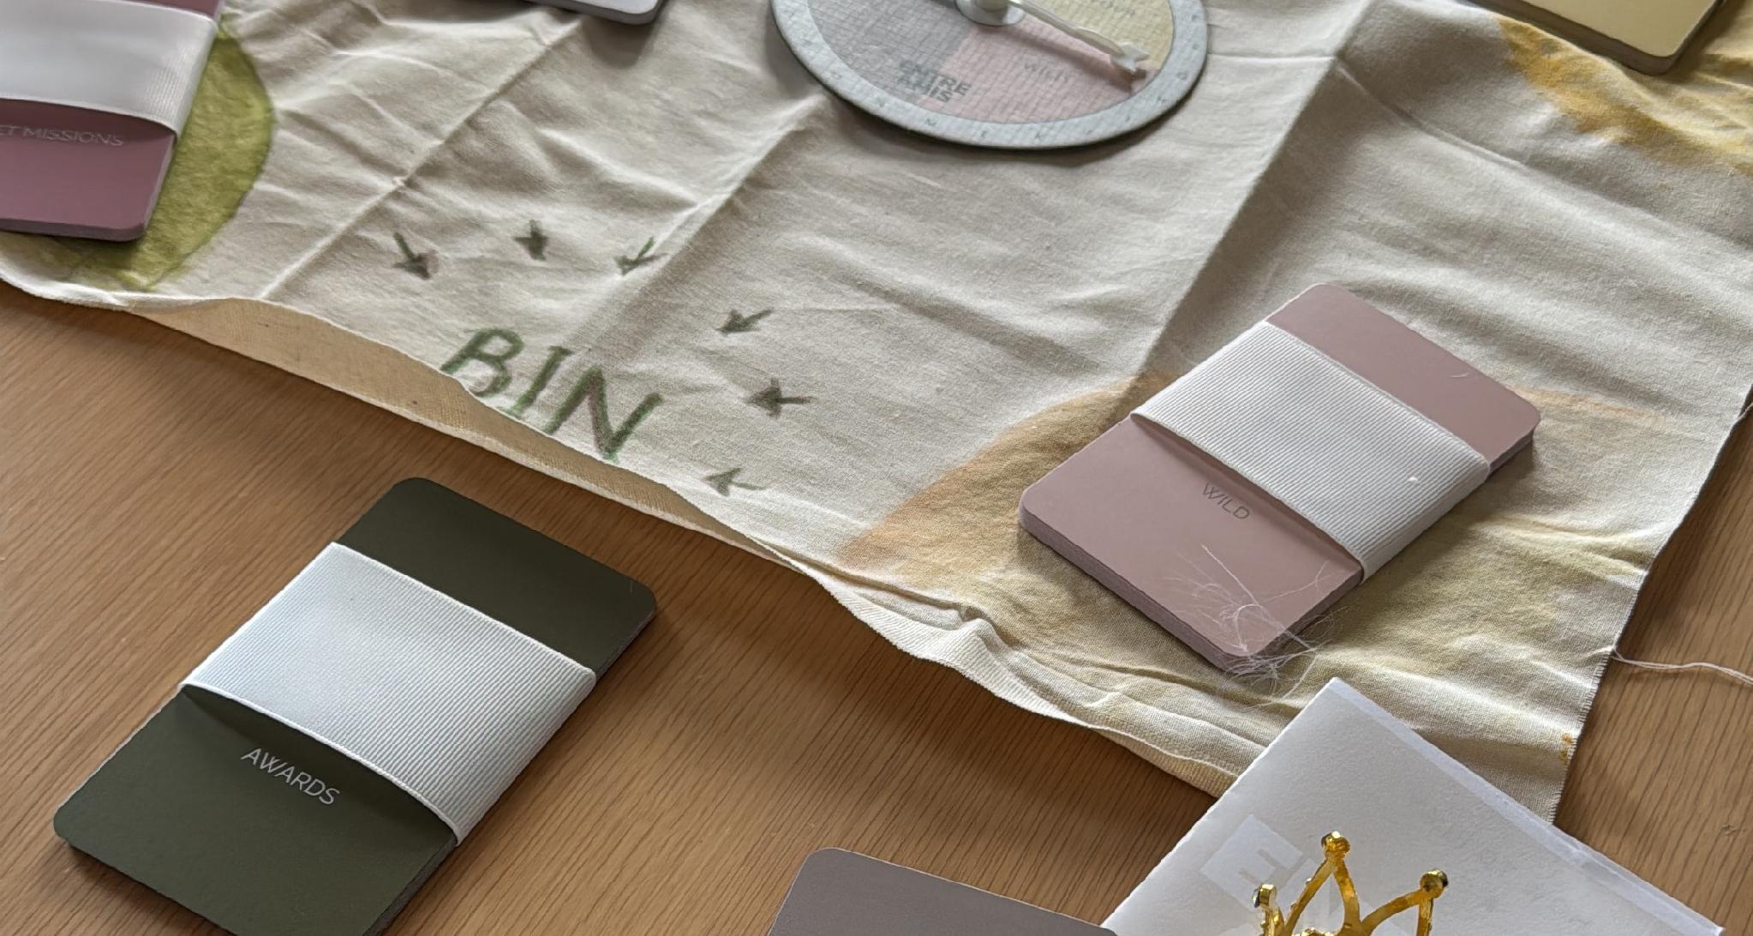
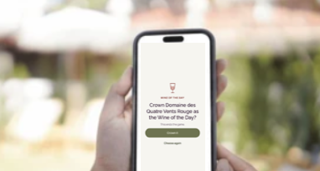
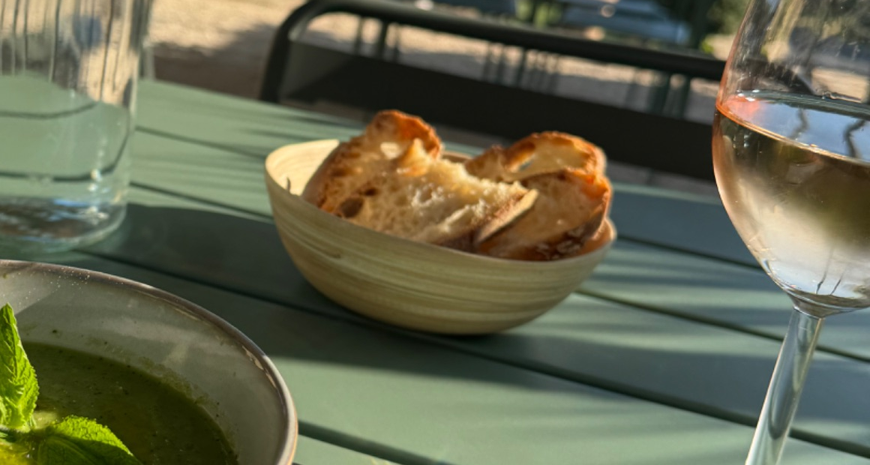
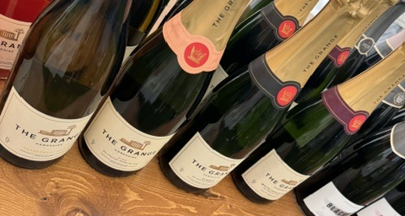
The Entre Amis world
Connection doesn’t end when the table clears.
Inspire
Discover
Experience
Belong
THE GAME
A table game that turns any wine into conversation, for two to eight players.
THE APP
Hosts the game, explains wine in plain English, and keeps My wines: a record of tastings and favourites.
PARTNER MODE
A hosted tasting that guests join, for a vineyard, bar, restaurant, retailer or wine club.
EVENT MODE
Entre Amis across a whole event, for organisers, producers and visitors. We're looking for a launch partner.
Notes:
DOES THIS DUPLICATE SLIDE 7USE IN: Brand story · Partner Mode pack · Event Mode pack
SECTION: Brand
28 OCT PASS: Subtitle widened beyond tasting: connection doesn't end when the table clears.
---
The journey is the confirmed Inspire → Discover → Experience → Belong (Brand Brain 00; founder, 21 October). The v2 line 'Discover → Play → Remember → Experience → Belong' is replaced: Play is not shown as a step.
Four parts of the Entre Amis world, all in development (nothing is launched); the tags are off the slide to let people imagine it (founder, v4 review). The game photo is the founder's prototype. Stays are left off (founder, 21 October). Event Mode: in development, and we're looking for a launch partner (founder, 21 October).

Slide 8


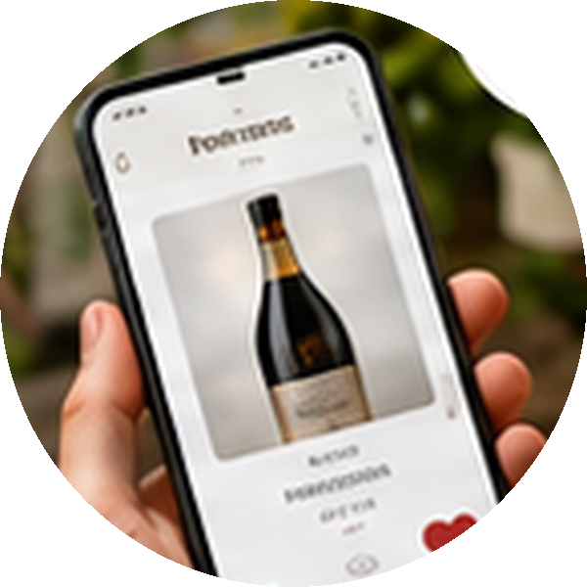



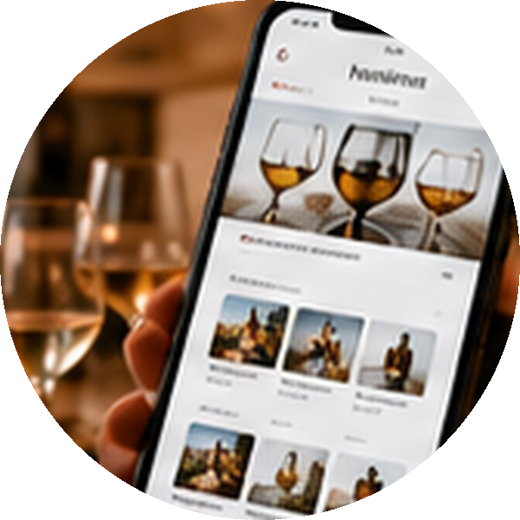
Sophie's Entre Amis life
ILLUSTRATIVE
Different experiences. One account. A richer relationship over time.
Hosting at home
Sophie hosts her first Entre Amis game. Everyone joins in, and new favourites go into her collection.
My wines
A special event
My wines Wine 101
Sophie goes to a wine event. It’s welcoming and fun, with new people, new wines and lasting memories.
The game + app
Rosé
Provence · 2024
Event Mode
At a friend’s table
Sophie joins a game at a friend’s house: good conversation, new wines and an occasion to remember.
Sparkling
England · 2021
Gifting and sharing
The game + app
Red
Rioja · 2020
Sophie gives Entre Amis as a gift and shares the experience with friends and family.
A vineyard visit
Sophie joins a hosted tasting at a vineyard. She discovers new wines and a connection to the place and its story.
White
Loire · 2023
The game
Partner Mode
Orange
Georgia · 2022
Her own discoveries
Taking it further
With Just tasting, Sophie explores wines on her own, saves favourites and builds her collection over time.
Sophie brings Entre Amis on her travels, and one day joins an Entre Amis stay: new places, new people.
The app
One account for every favourite, memory and connection.
Stays · the vision
Say what you really think.
Notes:
USE IN: Brand story · Internal master only
SECTION: Brand
28 OCT PASS: Rebuilt as editable PowerPoint shapes (founder, 28 October): the story, Sophie and the photos are kept; every word, tag and number is now editable. Real wines on the phone replaced with fictional ones (wine type, region, year; no producers). Tags use the section colours. Stop 7 shows stays as part of the vision. Sophie is illustrative, not a persona (personas are still TODO). Photos are crops of the original artwork; replace them with higher-resolution versions if you have them.
PASS 5 (28 OCT): numbers removed (the journey is not a sequence; the coloured product tags carry the link to each product). 1–4 now down the left, 5–7 down the right. Curved links run from every experience back to the one account, restoring the organic link to the core. The phone shows My wines as a listing, as the app does today.

Slide 9
The physical game
THE GAME
A wine game for people who would rather have an opinion than know the answer.
Savour
Pour
Wild
Mischief
Secret Missions
POUR, SPIN, PLAY, TALK
A beautifully made game, designed to sit at the centre of the table without taking it over.
Savour the wine.
Talk to the people at the table.
Picture where and when a wine belongs.
Take on Secret Missions.
Add a little mischief.
Savour, Pour, Wild and Mischief cards, Secret Missions, and a crown for the table’s favourite wine.
DESIGNED TO BE SHARED
Premium packaging, tactile quality and an object people are pleased to receive and use.
CONNECTED, NOT DEPENDENT
Complete without the app. The app adds more, and supports the table without becoming it.
2–8 PLAYERS · ANY WINE · A SINGLE GLASS IS ENOUGH · 18+
Corks are won for conversation, never for how much anyone drinks.
Talk. Laugh. Remember.
Say what you really think.
Notes:
USE IN: Brand story · Partner Mode pack
SECTION: The game
28 OCT PASS: App-only Word Play/Wine Knowledge line replaced with Pour. Added confirmed game facts, the corks rule and the game line Talk. Laugh. Remember. Time-neutral wording.
PASS 5 (28 OCT): sign-off line given the deck’s one sign-off treatment: deep olive band, cream SemiBold, centred.
PASS 3 (28 OCT): card family chips added in the game colours (Brand Brain 04: game colours may appear when they signify a family).

Slide 10
The connected experience
THE APP
Technology that brings more to the table without becoming the table.
The app connects play, wine discovery and memories around one simple experience.
“The app is there to support the table. It never becomes the table.”
PLAY
Host a game or join one. The app guides play, keeps things moving and lets everyone take part.
DISCOVER
Photograph a label to add a wine. Plain-English information and Wine 101 are there when curiosity appears.
REMEMBER
Keep the wines, reactions and moments you want to return to in My wines, on any device.
18+ AGE GATE ON ENTRY
IN DEVELOPMENT
ON YOUR OWN
Discovery doesn’t stop when the table clears. With Just tasting, Hosts can explore wines on their own.
Say what you really think.
Notes:
USE IN: Brand story · Partner Mode pack · Event Mode pack
SECTION: The app
28 OCT PASS: "Personal wine library" is now My wines. Label photo, Wine 101, Just tasting and the 18+ gate added, all claimable as in development.

Slide 11
Two ways to work with us
PARTNER + EVENT
Partner Mode for your own tastings. Event Mode for combined events.
PARTNER MODE
EVENT MODE
Hosted by you: a vineyard, bar, restaurant, retailer or wine club.
Your own tasting, around your wines.
Your guests, your questions, your story.
Insight on your tasting and your wines.
Run by an organiser: a festival, tasting event or regional wine body.
Many producers at one combined event.
Visitors move between tastings at their own pace.
Insight for the organiser across the event.
TO DECIDE Detailed feature differences between Partner Mode and Event Mode.
Notes:
USE IN: Partner Mode pack · Event Mode pack
SECTION: Partner + Event
28 OCT PASS: No copy change.
---
Lets a host see where they fit, and points organisers to the Event Mode pack.

Slide 12
What Partner Mode adds
PARTNER MODE
What we add isn’t content. It’s connection.
Wine businesses already have stories, tasting notes, expertise and product knowledge. We add the social layer.
BETWEEN PEOPLE
Turn tasting into conversation and shared discovery.
WITH THE WINE
People taste, talk and choose, so your wines become part of the occasion.
BEYOND THE MOMENT
Wines and memories saved, so the relationship carries on afterwards.
USEFUL INSIGHT
Understand how people really respond, in the words they naturally use. Anonymised, and only with consent.
Conversation creates connection. Connection creates insight.
Partner Mode is one host’s own tasting. Combined events with many producers use Event Mode.
Say what you really think.
Notes:
USE IN: Partner Mode pack
SECTION: Partner Mode
28 OCT PASS: Retitled. Contradiction fixed: events are Event Mode, not Partner Mode. Partner line added. "More memorable" benefit claim removed. Consent added to insight.

Slide 13
How a Partner Mode tasting works
PARTNER MODE
You host. We add the conversation.
Join
Taste and talk
Vote and discover
Note and favourite
Share and keep
Guests join your tasting on their phones.
Information on each wine and on you. Savour and Pour cards get people talking, if you'd like them.
Live votes, and your own questions and quizzes. Answers are revealed as discoveries, never as wrong.
Guests keep their own notes and favourite the wines they like.
Favourites are saved under My wines in their account. Notes are theirs to keep or share.
Notes:
USE IN: Partner Mode pack
SECTION: Partner Mode
28 OCT PASS: Quizzes framed as discoveries (Brand Brain 00).
---
From your description (12 October): hosted tasting; Savour and Pour cards as an option; host-specific questions and quizzes; interactive voting shared as a learning experience; guests collate and share notes; information about the wines and the vineyard; favourite and store wines in a profile.

Slide 14
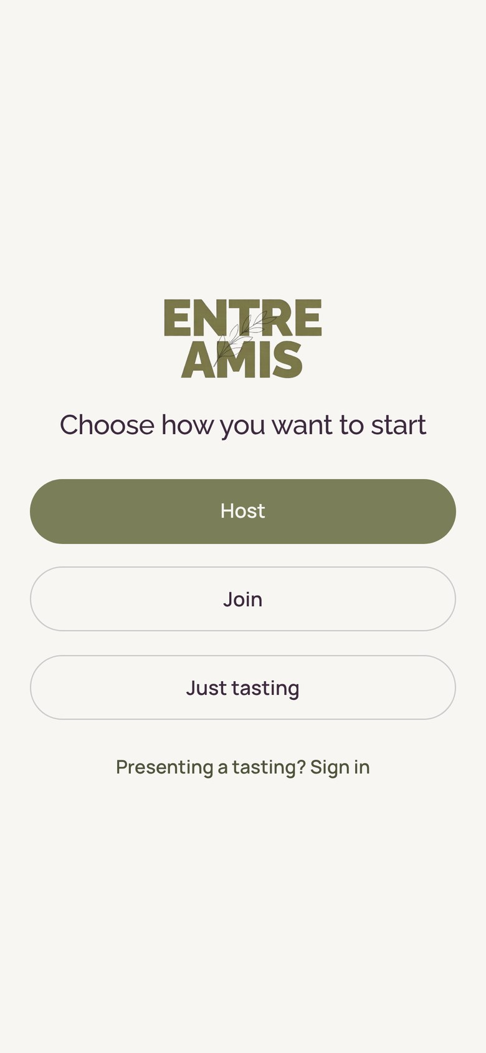
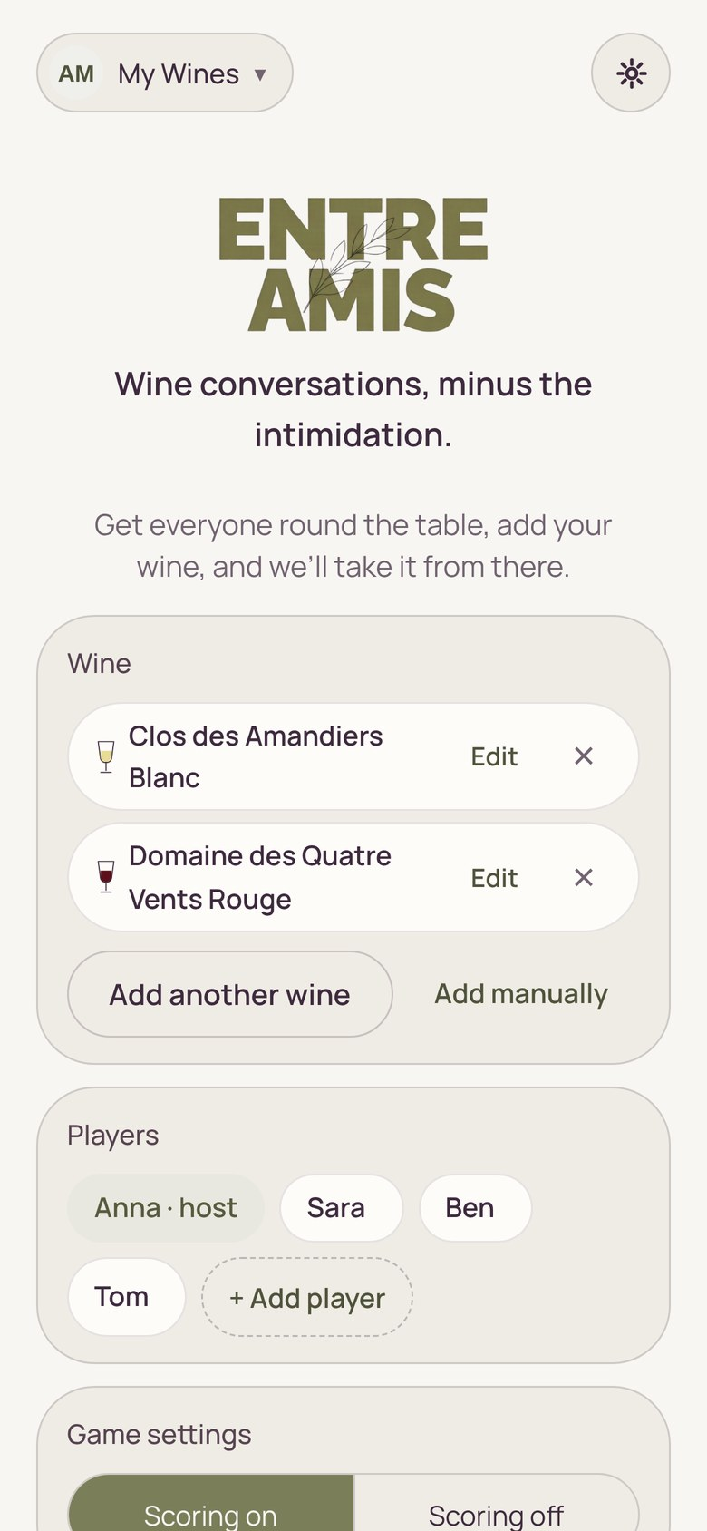
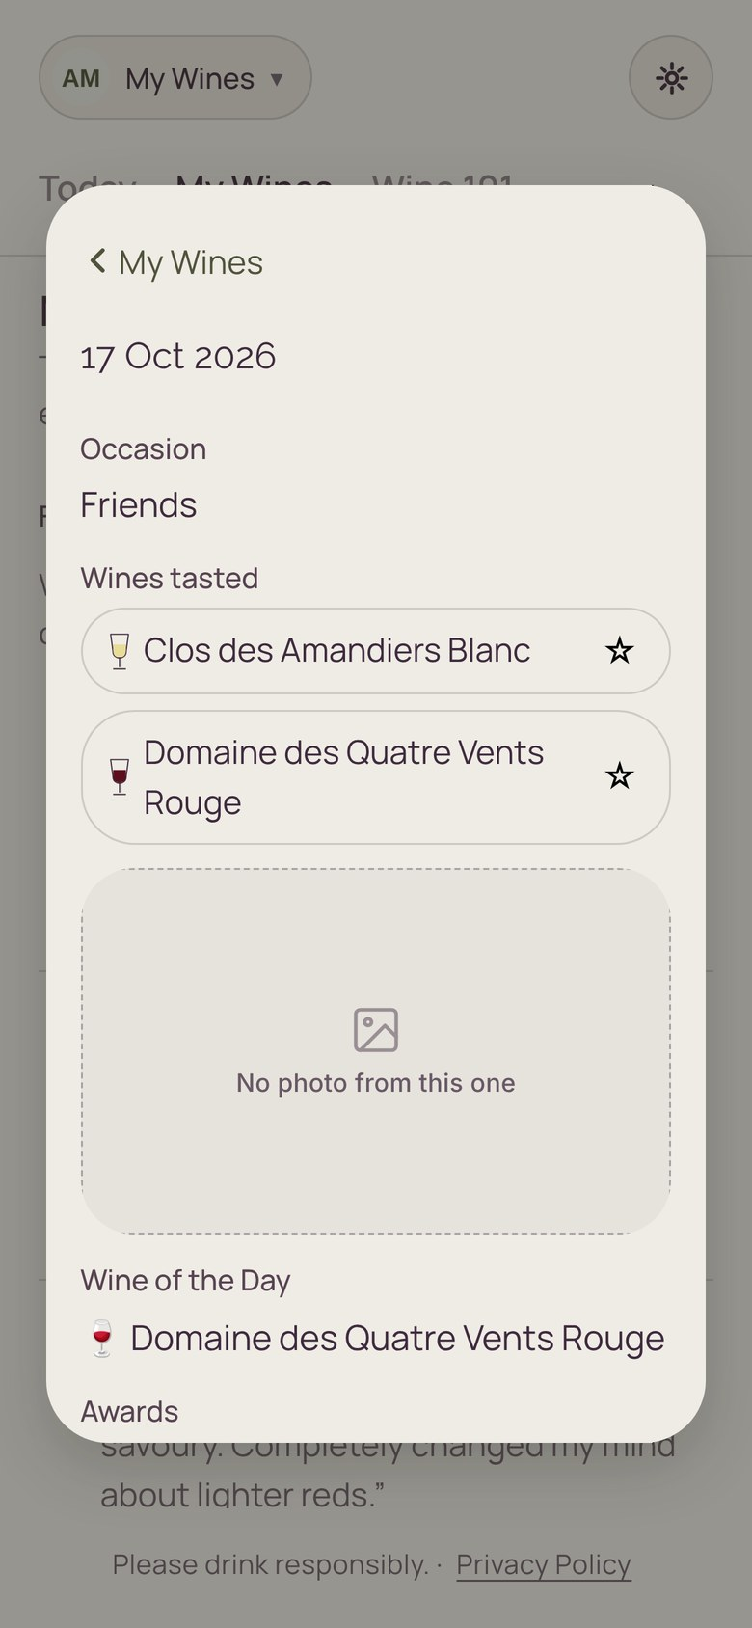
Just tasting
THE APP
Tasting on your own, at your own pace. There are no wrong answers.
FOUR QUESTIONS
Four guided questions for each wine help you notice what’s in the glass.
ONE WINE OR SEVERAL
Taste one wine or a few, side by side. A single glass of each is enough.
PHOTOGRAPH THE LABEL
Add a wine from its label. If the app doesn’t know it, it fills in the tasting details itself.
KEPT IN MY WINES
Every tasting is saved to My wines, to come back to on any device.
Start here
Just tasting sits beside Host and Join on the welcome screen.
Add the wine
Photograph the label or type it in. Shown here on the game set-up screen.
Kept in My wines
Each tasting is saved, to come back to on any device.
Notes:
USE IN: Brand story · Partner Mode pack
SECTION: The app
28 OCT PASS: New content, built only from confirmed functionality (Just tasting, label recognition, My wines on every device). Screens still to add.
PASS 5 (28 OCT): status box removed: Just tasting is built to the same level as the other ways to play (founder).
PASS 3 (28 OCT): screens added from the screen walkthrough (17 Oct). No screens of Just tasting itself were captured yet: the welcome and set-up screens stand in, and are captioned honestly. Replace with Just tasting screens when you have them.

Slide 15
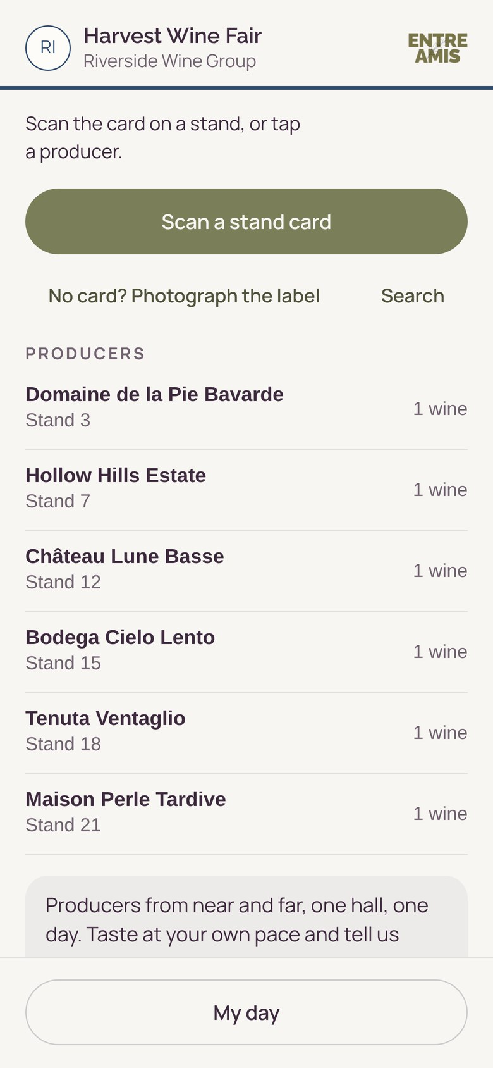
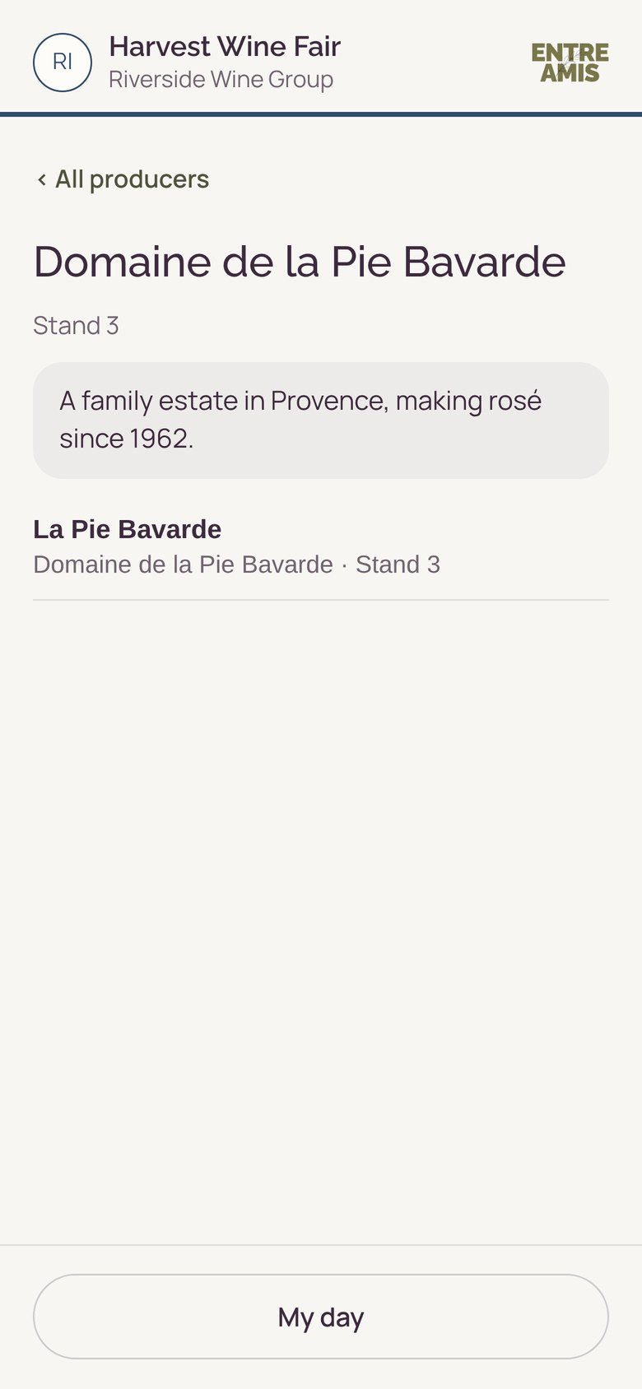
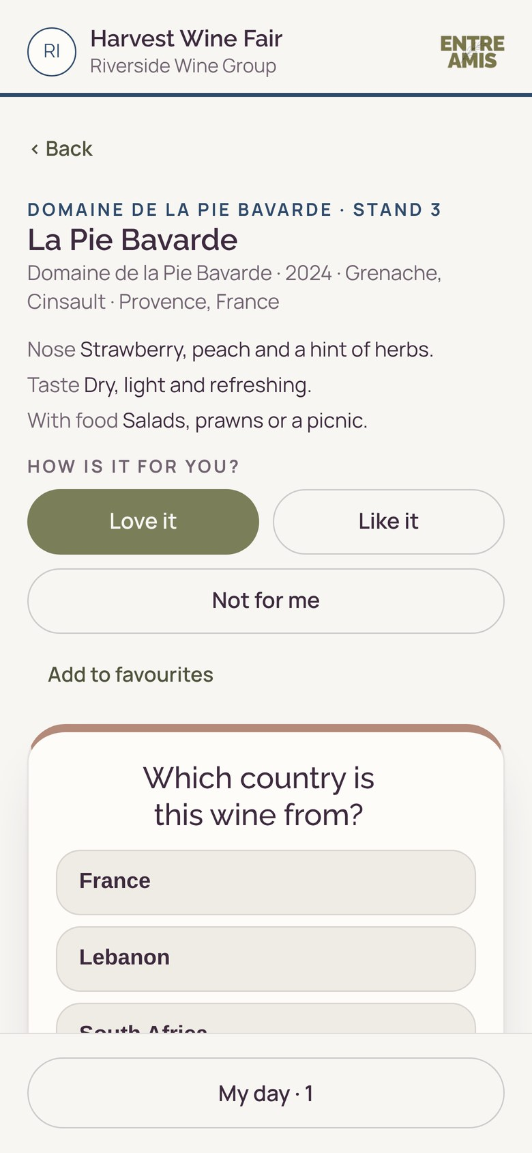
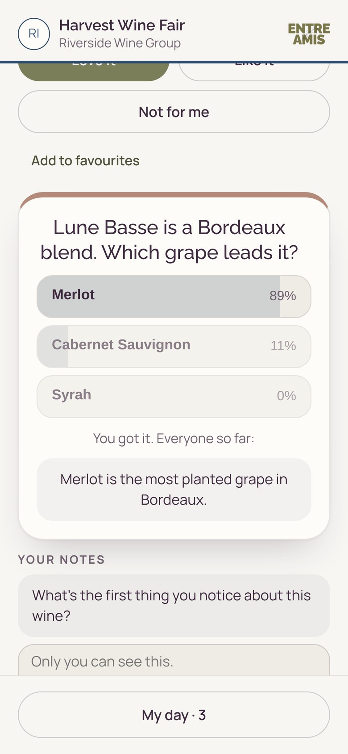
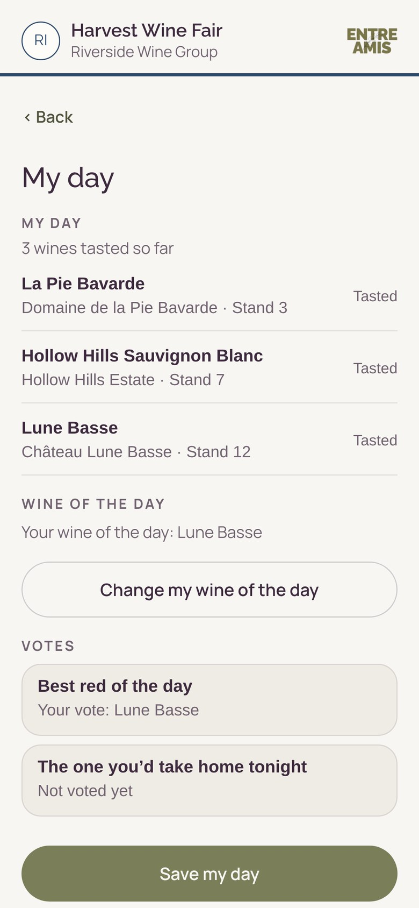
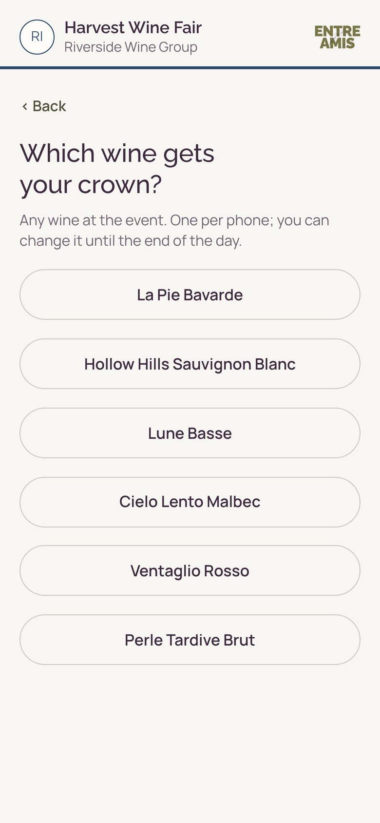
The visitor journey
EVENT MODE
Designed around what actually happens at a discovery day.
Arrive
Explore
Taste
Sit and talk
Save
Crown
Revisit
ACROSS THE WHOLE DAY
Quick to use
Easy to start, easy to join.
Optional questions
Answer as much or as little as you like.
No compulsory tasting
Tasting is always optional.
Tailored to each event
Adds to the day, and helps visitors remember it.
Notes:
USE IN: Event Mode pack
SECTION: Event Mode
28 OCT PASS: No copy change.
PASS 5 (28 OCT): Save screen now full size like the others (it shows the organiser vote "Best red of the day"; see the ranking point). The four principles now sit in one centred panel because they apply across the whole day. Updated journey screens to follow from the next live version.
PASS 3 (28 OCT): screens from the screen walkthrough (17 Oct), demo event with made-up producers. Save is cropped above the organiser votes, and the results screen is not used: both show producers ranked by percentage, which conflicts with the "No public ranking" promise (slides 21 and 26). Revisit shows a saved day in My wines from a host game.
---
Card bodies expand the October line: 'Quick to use. Optional questions. No compulsory tasting. Able to be tailored to enhance physical experience and help create lasting memories.' 'Enhance' and 'lasting memories' were benefit claims, so they're reworded.

Slide 16
My wines and memories
THE APP
Everything worth remembering, in one place.
TASTINGS
Every tasting, with the notes you made along the way.
FAVOURITES
The wines you loved, from a game at home, a partner tasting or an event.
OCCASIONS AND EVENTS
The occasions you shared, with the scores and the wines that went with them.
YOUR REACTIONS
Love it, Like it, Not sure, Not for me: your view, kept for next time.
ON EVERY DEVICE
Sign in with an email code and My wines is there wherever you are.
YOURS TO KEEP
Notes belong to the guest. Sharing them is always their choice.
Alongside it, Wine 101: wine facts and help, like a directory. My wines is personal; Wine 101 is for everyone.
STATUS Built in the app as a prototype. May be described as in development, never as complete (Brand Brain 00).
Notes:
USE IN: Brand story · Partner Mode pack · Event Mode pack
SECTION: The app
28 OCT PASS: New content, built only from confirmed functionality. INTERNAL: the data behind My wines and Wine 101 isn't fully logging yet; never say this externally, and never describe either as complete.

Slide 17
Entre Amis stays
STAYS
Not a tour. Not a retreat. More like staying with friends who know all the good places.
A future ambition: Entre Amis, lived for a few days rather than played for an evening.
Shared tables, never rigid itineraries.
Everything is optional.
Wine explained when you are curious, not taught at you.
Local places chosen because we love them, not because they are on a checklist.
Time to disappear for an afternoon if you want to.
One or two brilliant surprises.
A relaxed Provençal home where you can wander, read and swim.
The feeling that you are staying with friends who happen to know Provence rather well.
Say what you really think.
Notes:
USE IN: Brand story · Internal master only
SECTION: Stays
28 OCT PASS: Stays may be referenced as part of the vision (founder, 28 October). "Pour another glass" removed (responsible drinking).

Slide 18
The future of product
INTERNAL
Where the product could go next. Internal only.
THE GAME
The game mat as a printed, washable textile with original art. Artist editions and collaborations. A signature Entre Amis table setting.
EDITIONS
Seasonal Mini-Editions, such as Christmas. Curated Collaborations with chosen partners. A time-limited edition inside an Event Mode relationship.
THE APP
Live updates for Partner and Event Mode. Self-service set-up for partners. Content editing. Anonymised trend reports: decided in principle, not offered.
BEYOND WINE
Entre Amis stays: lived for a few days in Provence. Future non-wine expressions of connection, discovery and belonging.
Early thinking
Proposed (Brand Brain 06)
Planned improvements
The vision
Early thinking is never described externally, not even as “coming”. Editions wait on decisions ED2–ED10 in the commercial decisions brief.
Say what you really think.
Notes:
USE IN: Internal master only
SECTION: Internal
28 OCT PASS: Placeholder only. Early thinking is never described externally.
PASS 3 (28 OCT): drafted from Brand Brain 00 (early thinking, stays), 06 (themed editions, trend reports) and the build and release plan (improvements after the port). Nothing new invented.

Slide 19
The Entre Amis table
EVENT MODE
An invitation to experience the brand, never a sales stand.
The setting
The experience
The connection
A small, beautifully set table with comfortable seats, tactile details, and the game and crown naturally in place.
Short hosted conversations, tasting prompts and playful challenges. Never a hard sell.
Optional moments on the event screen. The table supports what visitors do on their phones; it’s never the centre of the event.
Commercial note: staffing, furniture, transport, setup and operational support must be covered by the agreed event fee.
Say what you really think.
Notes:
USE IN: Event Mode pack
SECTION: Event Mode
28 OCT PASS: Aligned to the Brand Brain and slide 29: a small table or corner with comfortable seats, never the centre of the event. Fee line kept and labelled as a commercial note.

Slide 20
Guest • Entre Amis • Partner
PARTNER + EVENT
How shared experiences create lasting relationships
GUEST
ENTRE AMIS
PARTNER
• Discovers and joins experiences
• Connects games, app and experiences
• Hosts or contributes an experience
• Enjoys conversation and discovery
• Helps people remember and revisit
• Engages people meaningfully
• Saves favourites and memories
• Supports ongoing relationships
• Receives agreed insights
• Returns, recommends or hosts again
• Manages permissions and privacy
• Connects again with permission
The experience comes first. Relationships and understanding grow from it.
PERMISSION FIRST
Personal information is never shared without consent. Partners receive agreed reporting and explicitly consented connections.
Notes:
USE IN: Partner Mode pack · Event Mode pack
SECTION: Partner + Event
28 OCT PASS: "Customer" is now "Guest". "Not shared by default" made absolute (founder, 28 October). Contacts stay pending legal review.

Slide 21
Honest insight starts with trust
PARTNER + EVENT
People only say what they really think when it's safe to.
Consent first Nothing is collected for your insight without clear, informed consent.
WHY IT MATTERS
Say what you really think. It only works if people are safe to. That trust is what makes the insight worth having.
Anonymised Opinions and responses are combined and anonymised, never linked to a name.
Never sold What someone says is never sold or passed on as individual data.
Personal crowns stay personal No public ranking of producers.
No re-identification No data shared across platforms.
Notes:
USE IN: Partner Mode pack · Event Mode pack
SECTION: Partner + Event
28 OCT PASS: Marker covers both modes. Promises made absolute (founder, 28 October); the TO DECIDE box is resolved and removed.
---
Built from the confirmed Partner Mode data rules ('That trust is the brand — Say what you really think only works if people are safe to do so') and the promises from the October deck's 'Three layers of insight'.

Slide 22
INTERNAL
ENTRE AMIS / WORKING MASTER
05 Partner and event value
Existing general partner proposition, Hambledon application and event formats. Kent-specific revisions are not yet approved.
Notes:
USE IN: Internal master only
SECTION: Internal
28 OCT PASS: Divider, restyled only.
PASS 3 (28 OCT): divider recoloured deep olive for clearer sections.

Slide 23
What wine businesses get
EVENT MODE
Six benefits for producers and venues. All are built in the prototype; three can’t be offered yet.
WHAT THE ROOM THOUGHT
Loved, saved and crowned, wine by wine. Shown only once 5 or more people took part, and never with a name.
CONTACTS WHO SAID YES
Visitors tick a box for each producer they want to hear from. Nothing is ticked for them.
YOUR STORY GOES HOME
Your wines, story and notes stay in each visitor’s My wines after the day.
A QUESTION ABOUT YOUR WINE
One question per wine. Visitors see how the room answered, then a fact you chose.
FOUND AT YOUR STAND
A printed QR card on each stand opens your producer page straight away.
A REASON TO CROWN
Visitors crown their Wine of the Day. Everyone who crowns is entered into a prize draw.
TO CONFIRM Prize draw: legal check (UK prize draw rules, CAP Code, Portman Group) and short terms before any real event. Results for businesses: built in the prototype (16 October), not yet seen by a partner. Not claimable yet: results, contacts and the prize draw.
Notes:
USE IN: Event Mode pack · Internal master only
SECTION: Event Mode
28 OCT PASS: Subtitle and status note updated to the Brand Brain (reports built 16 October). Three of six benefits are not claimable externally yet.

Slide 24
What you know after a tasting day
EVENT MODE
Often, only who bought the tickets.
WHO CAME
You often know the ticket buyer, not everyone with them. One person may buy eight tickets.
WHAT THEY THOUGHT
Visitors talk about the wines all day. Most of what they say isn't captured.
WHAT HAPPENS NEXT
The wines and producers visitors discovered are easily forgotten once the day ends.
Event Mode turns the conversations at your event into insight you can use, and gives visitors a reason to remember the day.
TO ADD Evidence for 'most of what they say isn't captured' and 'easily forgotten' from organiser conversations, so these read as findings, not assumptions.
Notes:
USE IN: Event Mode pack
SECTION: Event Mode
28 OCT PASS: No copy change. Insight bank #12 (WineGB Tourism Report 2024) could support the problem, cited with caveats.
---
Rewritten from 'The event opportunity: a real gap' so it speaks to the organiser's problem first. Ticket buyers and 'one person may buy eight tickets' are your points. 'Where do all the wines you discovered go?' becomes the third card.

Slide 25
The insight you receive
PARTNER MODE
Two layers, both built on consent.
1
Your tasting
Combined votes, quiz and tasting responses, favourites, and how guests used your content.
2
Your new contacts
Individual guests who choose to hear from you, and only them.
TO CONFIRM Layer 2 depends on the proposed contact rule and legal review.
Example report: Autumn Tasting at The Cellar House
Illustrative example
38
guests joined
How Lune Basse landed
Your question: which grape leads Lune Basse?
In their own words
Merlot
64%
fresh · smooth · surprising · lovely with food · new favourite
4
wines tasted
Love it 45%
Like it 30%
Cabernet Sauvignon
24%
126
reactions
Not sure 15%
Not for me 10%
Lune Basse was crowned the room’s Wine of the Day
Syrah
12%
Totals show once 5 or more took part. Never with a name.
Notes:
USE IN: Partner Mode pack
SECTION: Partner Mode
28 OCT PASS: No copy change. Consider reusing the slide 27 report design here.
PASS 3 (28 OCT): example report drafted. Every number is illustrative, like slide 27. The Cellar House and Lune Basse are the made-up demo names from the screen walkthrough. Reactions use the four app reactions; the question and its fact follow the partner tasting screens. Reports for businesses are built but not claimable yet.
---
In Partner Mode, contacts go to that one host only (proposed, Brand Brain 03). Wider Entre Amis trends are not promised in Partner Mode: they depend on how it is built (founder, 12 October).

Slide 26
Three layers of understanding
EVENT MODE
More understanding for organisers, without turning vineyards into public competitors.
Your event Combined discoveries, favourites, crown patterns, polls, quiz responses and content engagement.
1
OUR PROMISES
Personal crowns stay personal.
No public ranking.
No risk of identifying anyone.
No data sharing across platforms.
Visitor contacts New relationships with individual attendees who expressly opt in to hearing from you.
2
Wider trends Carefully anonymised, combined Entre Amis trends, where sample size and permissions support them.
3
TO CONFIRM Layer 2 depends on the proposed contact rule and legal review. Layer names now match their descriptions (they were swapped).
Notes:
USE IN: Event Mode pack
SECTION: Event Mode
28 OCT PASS: Promises made absolute (founder, 28 October); the TO DECIDE box is resolved and removed. Contacts stay pending legal review.
---
In the October deck the labels and descriptions didn't match ('Event insight' described wider trends). Renamed 'Your event', 'Visitor contacts' and 'Wider trends'. 'Insight' removed from headings (internal language). 'Remove re-identification risk' reworded as 'No risk of identifying anyone'.

Slide 27
Value for every vineyard
EVENT MODE
Beyond being tasted. Being remembered.
THE DAY AT A GLANCE
ILLUSTRATIVE EXAMPLE
1,240
wines tasted
386
favourites saved
212
comments
PRODUCER SUMMARY
Illustrative example
WHAT VISITORS SAID (ILLUSTRATIVE)
“Surprising, in the best way.”
Saved as a favourite
Votes by wine type
How results are shared
Your own wines only
Never ranked against others
Shown once 5 or more took part
No names, ever
“Delicious. My first time with English sparkling.”
Sparkling
48%
Crowned Wine of the Day
White
33%
Red
19%
Answered your question
“A new favourite. I’ll look for it again.”
What visitors said
Every result shows how many people it's based on. Nothing under five.
delicious fresh surprising elegant
first time with English wine crisp new favourite
BE DISCOVERED · BE REMEMBERED · UNDERSTAND
Notes:
USE IN: Event Mode pack · Partner Mode pack
SECTION: Event Mode
28 OCT PASS: Title updated per the v4 review note (was What Hambledon Vineyard could learn; built for the Hambledon application). Producer rankings ("Best sparkling: Vineyard A") replaced: they broke wine neutrality and contradicted slide 26. Visitor comments labelled illustrative.
PASS 5 (28 OCT): sign-off line given the deck’s one sign-off treatment: deep olive band, cream SemiBold, centred.
---
Saved wine memories, producer stories and aggregate insight, from the v2 copy.
Audit, 21 October: producer pages with stories are built (stories entered by Entre Amis for now); Save my day to My wines is built; a producer report sees only its own wines and questions, never the votes, and refuses anything under five people. Built in code, not yet live-tested. Meet the Maker videos are not built, so 'videos' is left off the slide.
Nothing suggests personal data is shared automatically. Producer contact permission is separate, unticked by default and explicit, per the contact-details rule the founder confirmed on 21 October; the wording still needs legal review. The producer summary and the visitor comments are illustrative: made up to show the kind of feedback a vineyard would see, never attributed to anyone (founder, v4 review). Title shortened to 'Value for every vineyard' and row status tags removed (founder, v4 review).

Slide 28
What your visitors get. What you get.
EVENT MODE
One experience, two sets of benefits.
YOUR VISITORS GET
Meet the Maker: producer stories, with videos to come.
Tasting prompts, polls, questions and quizzes, with no wrong answers.
Their wines and notes saved as they go.
Their own Wine of the Day, crowned.
A personal record in My wines, to revisit after the event.
YOU GET
Insight into what visitors really think, in their own words.
Combined, anonymised reporting on saved wines, crowns, polls and tasting responses.
A home for your producers' stories, and a view of how visitors use them.
New contacts, where visitors choose to hear from you.
A reason to reconnect after the event.
TO CONFIRM Quizzes are in both Partner Mode and Event Mode (28 October). The prize draw still awaits the legal check (slide 23).
TO CONFIRM Contacts: proposed rule, needs legal review.
Notes:
USE IN: Event Mode pack
SECTION: Event Mode
28 OCT PASS: Quizzes are in both Partner Mode and Event Mode (founder, 28 October). Meet the Maker videos marked as to come. Prize draw still awaits the legal check.
---
New spine for the pack, as you suggested. Visitor side from the October 'During / Personal / After' slide. Quizzes and prizes left off until decided: quizzes need to fit 'no wrong answers', and prizes near alcohol need checking against CAP and Portman Group rules. 'Save wines in seconds' isn't used: it's a speed claim.

Slide 29
What a partnership might include
EVENT MODE
A possible year-round relationship across your events.
DIGITAL
The visitor experience, your producers' content, saved discoveries, polls, consent journeys and reporting.
AT THE EVENT
A small Entre Amis corner and scheduled moments on your main screen, fully costed.
AFTER THE EVENT
The post-event visitor experience, combined insight reports, a partner review and a potential Christmas activation.
TO DECIDE The indicative price line is removed: nothing may be priced until confirmed. Pricing belongs in each organiser's proposal.
Notes:
USE IN: Event Mode pack
SECTION: Event Mode
28 OCT PASS: No copy change.
---
'Hosted Entre Amis Table' is now 'a small Entre Amis corner', in line with how Entre Amis shows up at events.

Slide 30
How we'll show it working
EVENT MODE
The experience and evidence first.
CLICKABLE PROTOTYPE
Your visitors' screens: discover, Meet the Maker, tasting prompts, save, crown, join in, memories and consent.
EXAMPLE INSIGHT REPORT
An illustrative dashboard and post-event report. Every number tied to a real interaction.
FIRST EVENT PILOT
Defined scope, costs, responsibilities, no exclusivity, and measures of success for your first event.
TO CONFIRM Where each is today: prototype built and working (15 October), with visitor and organiser screens and stand QR cards. Report screens built (16 October), not yet seen by a partner. First pilot: planned.
Notes:
USE IN: Event Mode pack
SECTION: Event Mode
28 OCT PASS: Status note updated to 16 October.
---
From 'Before we build event partner mode'. The 'Ecosystem story' card was a note about the deck itself, so it's left out.

Slide 31
A founding partnership, not exclusivity
EVENT MODE
Help shape the Entre Amis event experience.
Founding experience partner
Co-design input, launch recognition, tailored event configuration and a shared post-event learning review.
Two-year insight benefit
Enhanced reporting and strategic insight conversations, within defined deliverables and data-quality thresholds.
Enduring preferential rates
Preferential rate for comparable future events; annual adjustments and expanded scope agreed separately. No exclusivity.
Say what you really think.
Notes:
USE IN: Event Mode pack · Internal master only
SECTION: Event Mode
28 OCT PASS: Founding partnership terms agreed (founder, 28 October). Still belongs in an individual organiser proposal.

Slide 32
INTERNAL
ENTRE AMIS / WORKING MASTER
06 Commercial opportunities and routes to market
The existing routes to value. Commercial figures are assumptions unless confirmed in the commercial decision log.
Notes:
USE IN: Internal master only
SECTION: Internal
28 OCT PASS: Divider, restyled only.
PASS 3 (28 OCT): divider recoloured deep olive for clearer sections.

Slide 33
Why now
Today’s world is more connected than ever, but not always closer.
Digital communication is part of everyday life. Yet being in touch is not the same as feeling connected. Real-world experiences, relaxed conversation and shared moments have a different kind of value.
DIGITAL EVERYWHERE
TIME TOGETHER
MEMORIES THAT LAST
We communicate and discover through screens, but technology alone cannot create closeness.
Shared tables and real-world experiences offer space to be present, curious and open-minded.
The moments that stay with us are often conversations, discoveries and stories shared with others.
Say what you really think.
Notes:
USE IN: Brand story · Partner Mode pack · Event Mode pack · Internal master only
SECTION: Brand
28 OCT PASS: Retitled "Why now": this is a point of view, not customer research (evidence still TODO). Typo fixed. Strong opener for shared versions.

Slide 34
The physical game market
INTERNAL
An established market with opportunities for distinctive social experiences.
A large, active market
SPIEL Essen 2026 attracted a reported 230,000 visitors, with approximately 1,900 new games.
Social, accessible and design-led games offer opportunities beyond traditional board-game enthusiasts.
A different kind of experience
Existing wine games often emphasise knowledge, trivia or getting the answer right.
Entre Amis puts conversation, participation and shared discovery at the centre.
Premium presentation and gifting are important parts of the proposition.
More than one route to market
Specialist games retailers and premium gifting.
Vineyards, hospitality, events and experience-led retail.
Potential publisher, distributor or licensing partnerships.
The opportunity: A premium social game people choose for the experience it creates, not the knowledge it tests.
Say what you really think.
Notes:
USE IN: Internal master only
SECTION: Internal
28 OCT PASS: SPIEL Essen 2026 figures are not in the insight bank: source-check and add as PROPOSED. Comparison with other wine games is a claim to flag before external use.
PASS 5 (28 OCT): sign-off line given the deck’s one sign-off treatment: deep olive band, cream SemiBold, centred.

Slide 35
The digital experience market
INTERNAL
Established wine apps serve different needs, leaving an opportunity to test a more connected experience.
A fragmented competitive landscape
Vivino: Wine discovery, ratings and purchasing.
CellarTracker / InVintory: Collections and cellar management.
WineGame / TasteWine: Gaming and guided tasting.
Rewine: Digital engagement for individual wine venues.
UK Vineyard Guide: Vineyard and experience discovery.
Where Entre Amis is different
Social play and shared experiences rather than individual wine expertise.
A personal record of discoveries, favourites, people and occasions.
Connections between consumer experiences, venues and events.
What still needs validating
Whether customers value the combined experience enough to pay for it.
Whether partners see sufficient value in engagement, insights and ongoing relationships.
The opportunity: To turn an enjoyable shared occasion into something people remember, revisit and build upon.
Say what you really think.
Notes:
USE IN: Internal master only
SECTION: Internal
28 OCT PASS: Competitor names approved for this master (founder, 28 October).
PASS 5 (28 OCT): sign-off line given the deck’s one sign-off treatment: deep olive band, cream SemiBold, centred.

Slide 36
Revenue streams
INTERNAL
One connected brand. Multiple ways to create commercial value.
Physical Game | Connected App | Partner Mode | Event Mode | Curated Editions and hosted experiences
Product sales or licensing royalties | One-off Host purchase; Guests free | Paid partner experiences and annual licences | Event fees, activations and reporting | Selective collaborations, limited editions and potentially Entre Amis Says.
Route under evaluation | Proposed model | Pilot model exploration | Pilot model exploration | Future opportunities, not launch revenue
Notes:
USE IN: Internal master only
SECTION: Internal
28 OCT PASS: Content approved as is (founder, 28 October). App payment model is still TODO in Brand Brain 06.

Slide 37
Routes to market
INTERNAL
Different routes to customers. One connected Entre Amis brand.
Route | How we reach the market | Current position
Physical game | Direct online sales, premium gifting, specialist retailers, or a publisher/distributor licensing agreement | Manufacturer quotes underway. Licensing being explored.
Connected app | App stores, website, physical-game buyers, guest invitations and partner/event experiences | One-off Host purchase proposed. Guest access free.
Vineyard and venue partners | Direct relationships with vineyards, wineries, hospitality, retailers and wine clubs | English and French launch partners being sought.
Events and festivals | Direct approaches to organisers, regional wine bodies and producers | Fizz Fest and Wine Garden of England among priority opportunities.
Future expansion | Curated collaborations, limited editions, new experience categories and hosted stays | Longer-term opportunities, not launch commitments.
Notes:
USE IN: Internal master only
SECTION: Internal
28 OCT PASS: Fizz Fest spelling corrected (founder, 28 October). "Manufacturer quotes underway" still conflicts with Brand Brain 06.
PASS 5 (28 OCT): route numbers removed; nothing else in the deck refers to them.

Slide 38
Commercial economics
INTERNAL
Working positions for discussion. Only the £40 RRP is confirmed.
Stream | Working position | Status | To resolve
Physical game price | £40 RRP, standard box (£33.33 ex VAT) | Confirmed | —
Licence royalty | 15% (commercial pack), or 20–25% of the ex-VAT price: about £6.67–£8.33 a game | Hypothesis | Royalty basis, guarantee, the route itself
Unit cost | £8.50 for the standard box, without the game mat | Under investigation | The quantity it is based on
Availability | Stock likely from May 2027 | Under investigation | Production route and lead time
App | One-off Host purchase; Guests free | Proposed model | Payment options (06: TODO)
Partner and Event Mode | Partners pay for insight | Pricing TODO | PO4 cost to serve; what reporting includes
Seasonal Mini-Editions | £0.55 or £0.95 a pack, or free as goodwill | Hypothesis | Payments; base case is no direct revenue
Advisers and referrals | Commission is a cost of winning revenue; no rate set | Proposed | PO4 cost to serve; written terms first
Every figure except the £40 RRP is a working hypothesis (Brand Brain 06). No edition income goes into near-term forecasts until a pilot has run.
Notes:
USE IN: Internal master only
SECTION: Internal
28 OCT PASS: Unfinished. Placeholder only; nothing invented.
PASS 5 (28 OCT): unit cost and availability now under investigation (founder).
PASS 3 (28 OCT): drafted from Brand Brain 06 and the commercial decisions brief (24 Oct). Nothing added beyond what those hold; the ex-VAT price and royalty range are 06's own arithmetic.

Slide 39
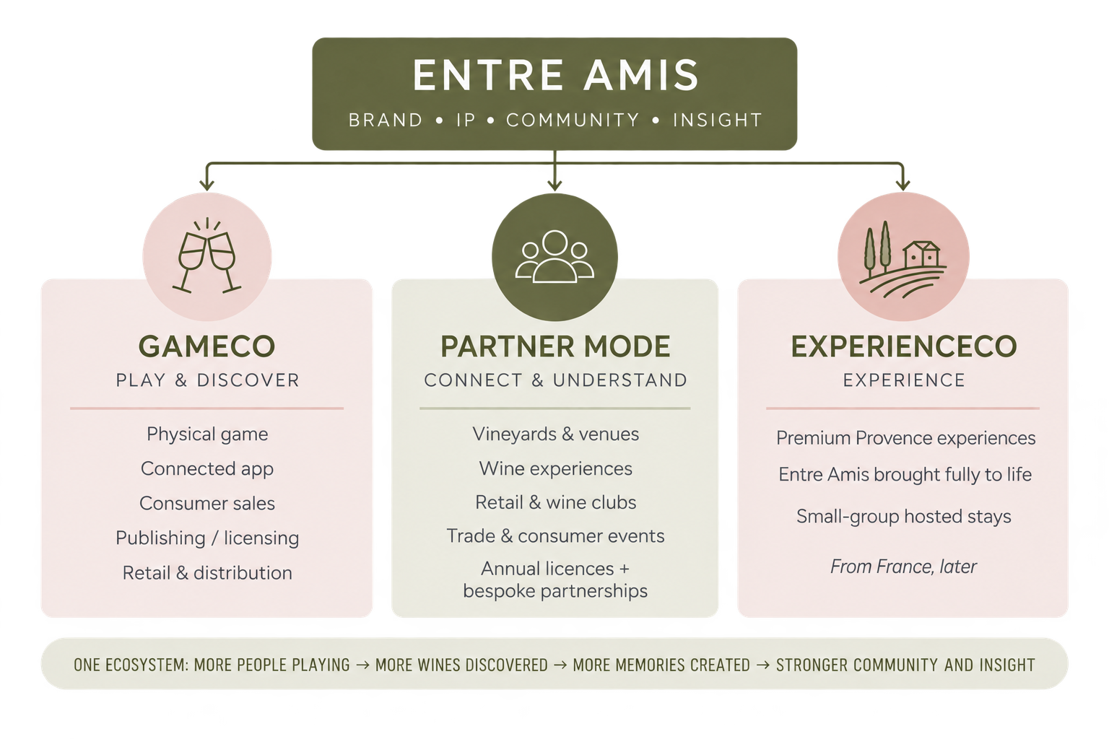
How Entre Amis grows
INTERNAL
One brand. Different routes to value.
Say what you really think.
Notes:
USE IN: Internal master only
SECTION: Internal
28 OCT PASS: Image not edited. GameCo/ExperienceCo, IP and ecosystem are internal language.

Slide 40
Brand protection and ownership
INTERNAL
One brand. Protected intellectual property. A structure designed to grow.
Brand Protection UK trademark application filed September 2026 across six classes. EU protection planned. Core domains and social handles secured. | Intellectual Property Entre Amis brand, original game content, designs, digital platform, software and curated content. Rights and contractual ownership to be documented and protected.
Ownership Founder retains 75% equity; five shareholders hold 5% each. Governance, shareholder rights and future investment arrangements to be formalised as required. | Business Structure Proposed group structure supporting physical products, digital experiences and commercial partnerships, while retaining control of the wider brand and platform. Final legal structure subject to advice.
Protect the brand. Retain the platform. Partner selectively.
Notes:
USE IN: Internal master only
SECTION: Internal
28 OCT PASS: Trade mark status and equity are never external. Brand Brain spells it "trade mark".
PASS 5 (28 OCT): box headings set in Raleway Bold, larger, so they stand out.
PASS 5 (28 OCT): sign-off line given the deck’s one sign-off treatment: deep olive band, cream SemiBold, centred.

Slide 41
Funding and launch
INTERNAL
A draft launch path. Funding is still to decide.
1
Now
Prototype and playtesting. The game is playable; the app, Partner Mode and Event Mode work live as prototypes.
Funding: to decide
No funding figures yet. Investors are deferred in the Brand Brain.
What launch needs funding
The physical game route, app production readiness, legal review and the first events.
How it could be funded
The founder and shareholders (slide 40), income from first partners, or investment if you decide to seek it.
2
Before the first real event
Production readiness (BR1–BR3), privacy notice and legal review (L1), multi-device Event testing. Fizz Fest: date to confirm.
3
Company formed
Readiness level 1, and the data controller confirmed.
4
Physical game route
Licence or self-manufacture decided. Stock likely from May 2027 (hypothesis).
Notes:
USE IN: Internal master only
SECTION: Internal
28 OCT PASS: Unfinished. Placeholder only; investors are deferred in the Brand Brain.
PASS 3 (28 OCT): launch path drafted from the build and release plan (22 Oct), the commercial decisions brief and Brand Brain 06. Funding holds questions only: no amounts are invented.

Slide 42
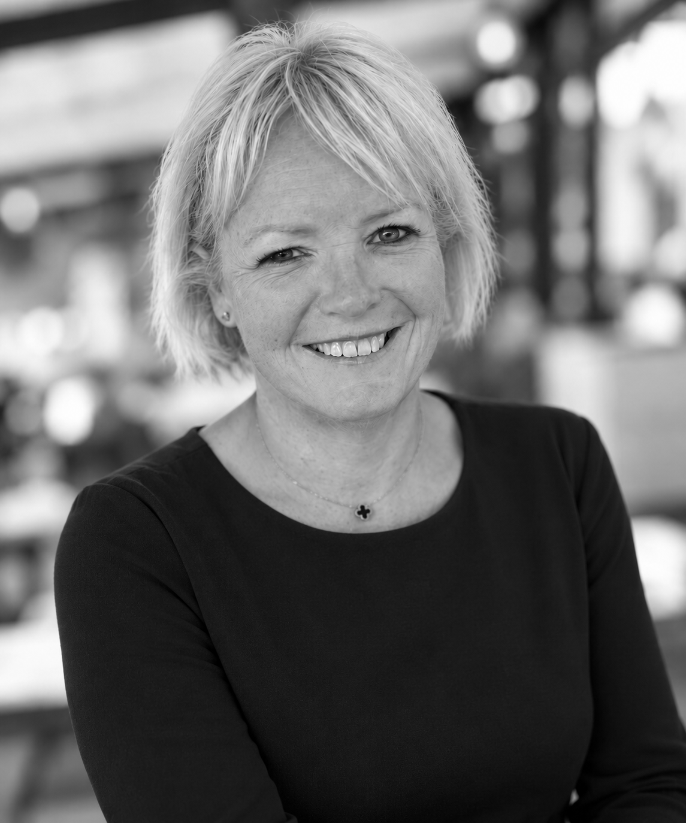
Why work with Entre Amis
A founder-led business with a wider world of expertise.
Entre Amis brings together a passion for wine with decades of experience building brands, engaging customers and developing commercially valuable experiences.
Commercial experience
Founded by Caroline, a senior marketing and commercial leader with over 30 years’ experience across consumer brands, retail, heritage and customer experience, and WSET Level 3 with Distinction.
Creative thinking
A distinctive approach to brand, game design, digital experiences and storytelling, with access to specialist creative and design expertise.
A connected network
Relationships across buying, brand leadership, advertising, design and the arts, creating opportunities to bring complementary expertise into selected collaborations.
Notes:
USE IN: Partner Mode pack · Event Mode pack · Brand story
SECTION: Founder
28 OCT PASS: "More than 25 years" corrected to "over 30 years". Founder facts approved as written (28 October); Brand Brain 01 to be updated to match. Surname to add.

